Slide 1

“Supermarket Billing System”
DHAKA UNIVERSITY OF ENGINEERING & TECHNOLGY,GAZIPUR
DEPARTMENT OF COMPUTER SCIENCE AND ENGINEERING
PRESENTATION ABOUT OBJECT ORIENTED PROGRAMING FINAL PROJECT ON
COURSE NAME: OBJECT ORIENTED PROGRAMMING LANGUAGE SESSIONAL
COURSE CODE: CSE 1122
Presented To:
Mss.Sabah Binte Noor
Assistant Professor,CSE
Presented By:
Name: Abdullah Al Mamun
ID:194011
CSE 2/1

Slide 2
OBJECTIVES OF THE PROPOSED SYSTEM
To reduce time for the organization
To increase efficiency and accuracy of the system
To reduce pressure on the labour and relieving man
power from repetitive and dull job
To make the retrieval of information faster
To make the system more feasible
To reduce large amount of paper work
To make the system more reliable to avoid any
ambiguity.
To reduce the cost factor of the system
To make the system more flexible.

Slide 3
Introduction
The project is on Supermarket Billing. Supermarket is the place where customers
come to purchase their daily using products and pay for that. So there is a need to
calculate how many products are sold and to generate the bill for the customer.
“Super Market billing system” aims at developing into software that can be used at
places like Shopping malls, Super Markets to easily maneuver the daily tasks of
taking the order, calculating the bill etc. The main advantage of this project is that
it converts all the manual work which is time consuming and error prone to fully
automated system which helps in eliminating all the paper work, saves time,
Improves customer services. It also speeds up various processes such as addition
of new items to the menu, deletion of items from the menu, modification of details
of items and calculation of bills thus providing convenience to the workers as well
as customers. In the development of the project , selection of an appropriate
programming language and a platform is of primary importance. The major part
of the credit goes to the software environment chosen by the developer. Selection
of a language from the ocean of languages is very difficult , a developer has to
consider various features and functionalities that a particular language can
provide. In this project c++ language is used to maintain all the data. It provides
many features like file handling ,data can be easily maintained and many
features that are required while doing a project.

Slide 4
ADVANTAGES OF THE PROPOSED SYSTEM
Converts all the manual work which is time consuming and error prone to fully
automated System
Helps in eliminating all the paper work, saves time and improves customer
services.
Makes the addition of items in the menu, deletion of items and modification of
items in the menu easier and faster.
C++ has support for most of the web servers available today
Bills can be calculated more easily and with more accuracy
Reduces pressure on the labour.
Makes the system more feasible and flexible and thus retrieval of information
becomes convenient.
Disadvantages:
There is lack of personal attention.
It require large and extensive premises.
Goods which require explanation by
salesman cannot be sold in such markets.

Slide 5
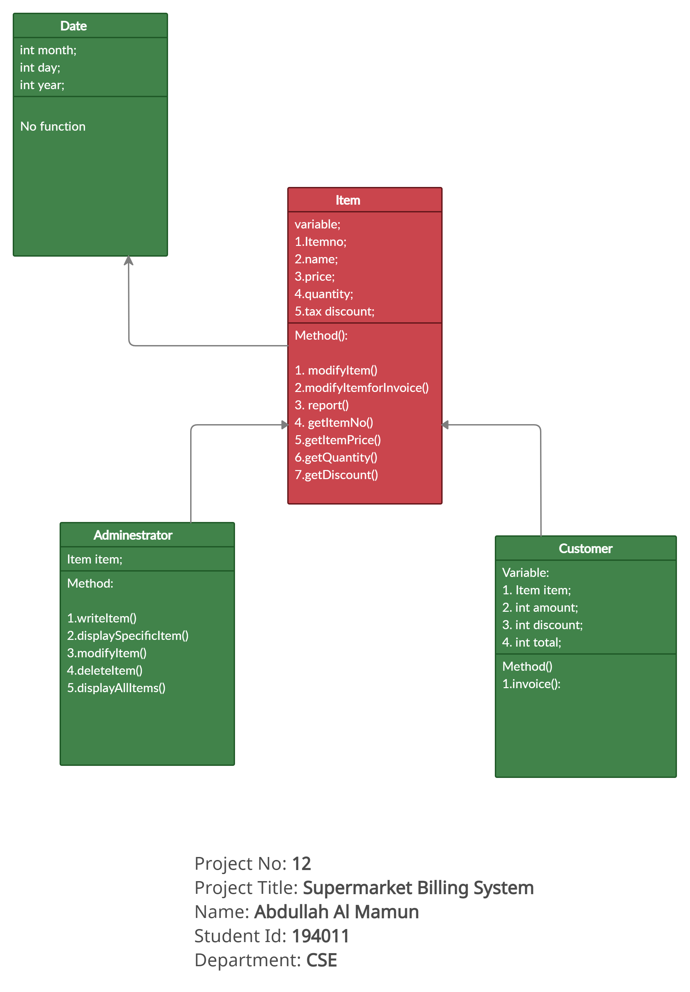
Project Diagram

Slide 6
Working
This project mainly consist of three menus
☺Customer
☺Admin
☺Exit
Custormer Menu shows product list with Product no.,
name and price. This menu is used to place order. The
steps involved are:-
1.Enter the product no. of the product from
the list
2.Enter the quantity
3.Then place your order
Administration menu consist of the following options:
1. Create Product
2.Display all product
3.Query
4.Modify product
5.Delete product
6.View product menu
7.Back to menu
Enter choice
• When we choose the first option i.e. Create product,
we need to mention product no, name, price, and
discount of the product to create product.
• When we choose the second option i.e. Display all
product, then all the details of the product is
displayed one by one with product no., name, price
and discount.
• If we choose the third option i.e. Query, the we have
to enter the product no. to see the details of the
respective product.
• 4th option i.e. Modify product is used to modify the
product list, we have to mention new product no.,
name, price and discount.
• When we choose the 5th option i.e. Delete product,
then we have to mention the product no, of those
product which is to be deleted.
• If we choose the 7th option i.e. View Product menu,
then product menu is displayed.
Exit menu is used to come out of the program

Slide 7
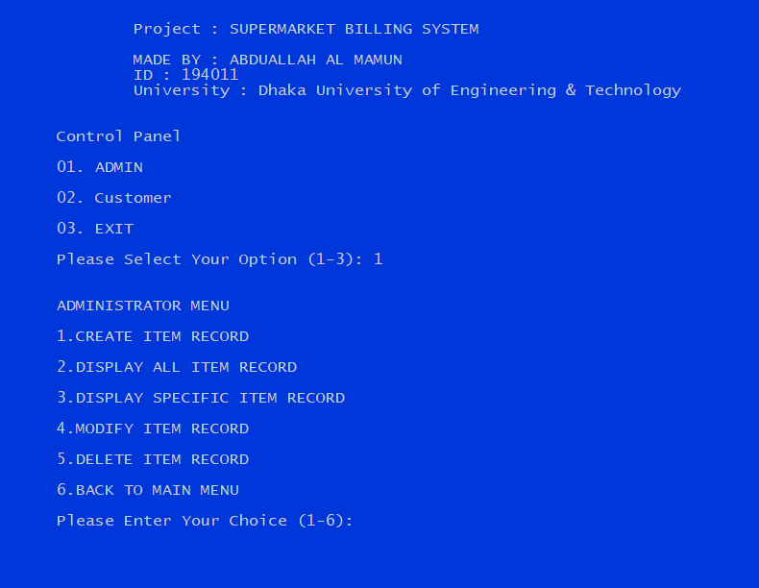
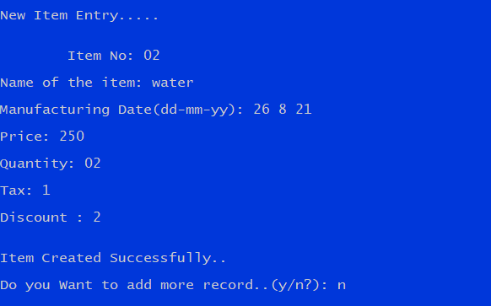
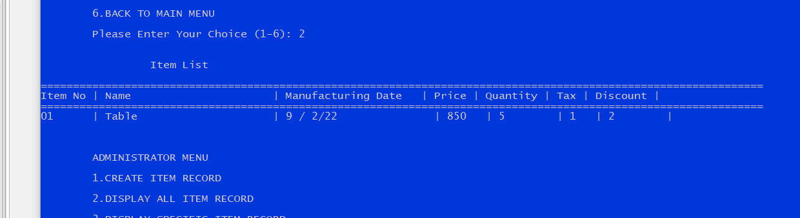
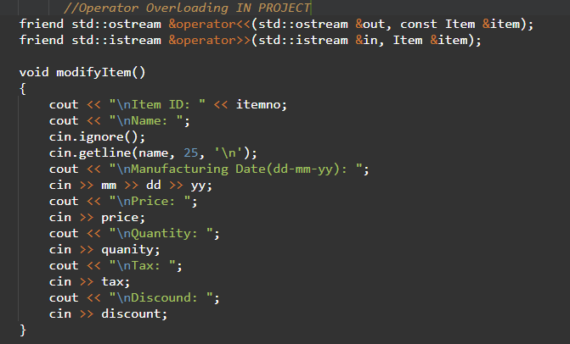
OUTPUT

Slide 8
CONCLUSION :
My project and implementation is on Supermarket Billing System. We have successfully completed it. We take this opportunity to express our sense of indebtedness and gratitude to all those people who helped us in completing this project and implementation.
This project and implementation has contributed a lot to our knowledge that has proved to be a value addition for me.

Slide 9
Thank you

